Slide 1



Information and Communication Technology
in
Manas Pattnaik
Member Technical
e-Committee
Email: manaspattanaik@indianjudiciary.in

Slide 2
Indian Advantages

Slide 3

Where Opportunity is Matched by Diversity
India, the world’s largest democracy and home to more than one billion people, is quietly but quickly emerging a leader
in the field of software arena
  World Class Quality
  Cost-Effectiveness
  High Reliability, Rapid Delivery
  State-of-The-Art- Technologies and Infrastructure
  Supportive Govt. Policies
  Geographical Advantages

Slide 4

Contd….
World 2nd largest English Speaking Manpower Resources in the World
The rich experience & expertise of a vast pool of trained manpower of both software & hardware engineers, quickly moving up the value chain & knowledge workers adept at all IT jobs.
India is emerging as an attracting outsourcing destination to companies around the world in the Information Technology.

Slide 5
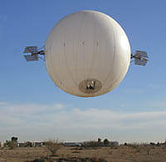
Contd….
On the eve of the 21st Century India has emerged a dynamic nation transformed by the process of liberalization.
Encouraging foreign and domestic investment allowing the setting of industries.
Offering a world of highly skilled human resources for utilization.
Moving with the times & working fast towards convergence of sectors like telecom with IT for faster growth of IT.

Slide 6
India- Emerging Knowledge Base Economy of the 21st Century

Slide 7
India - Overview
Largest democracy in the world & 4th largest economy in terms of Purchasing Power Parity (PPP)
Sustained GDP growth over the last decade over 6%
Growing trade: Exports USD 80 billion, growth 24%; Imports USD 105 billion, growth 34% (2004-05)
Next $1 Trillion Economy(by 2012): Goldman Sachs
Great demographics( 54% of population below 25 years)

Slide 8
India’s Emerging Knowledge Industries
Design / R&D : Over 100 Centers by Fortune 500
Knowledge services: Financial Analysis to Chip Design
Bio-Tech: Already $1.0 B Revenue, $5.0 B by 2010; 56% Exports by over 100 Companies
Pharma: Over $5.0 B Revenue, $25.0 B by 2010
Health Care: Remote Diagnostics, Patent Records, Clinical Trials and 150,000 Medical Tourists annually.

Slide 9
Indian IT Industry -An Overview (2004-05)
Industry Turnover (2004-05) US $ 27.75 billion
Hardware Domestic: US $ 5 billion
Hardware Exports: US $ 1.25 billion
Software Exports: US $ 17 billion
Software Domestic: US $ 4.5 billion
PC penetration (March 2005) 14 per 1,000 people
Domestic IT Spend 1.5% of GDP

Slide 10

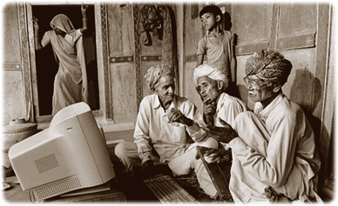

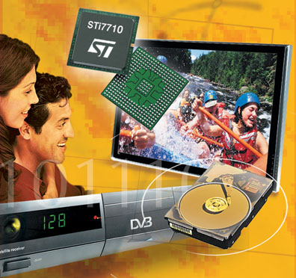

India: Fast Growing Market …
India Hardware Industry projected at US $ 60 billion by 2008
4 million PC Shipments – 2004
2.5 million broadband in 2004
65 million mobile subscribers
- 2004
14 Mil PC Shipments - 2008
10 million broadband in 2008
200 M Mobile subscribers by 2007
1 million Set Top Box – 2004
9.25 million TV Sets – 2004
2 million cell phone subscribers added every month
Sub $ 40 Mobile Phone
Sub $ 225 PC ‘s would increase PC penetration.
15 million Set Top Box - 2008
16 million TV Sets – 2008

Slide 11
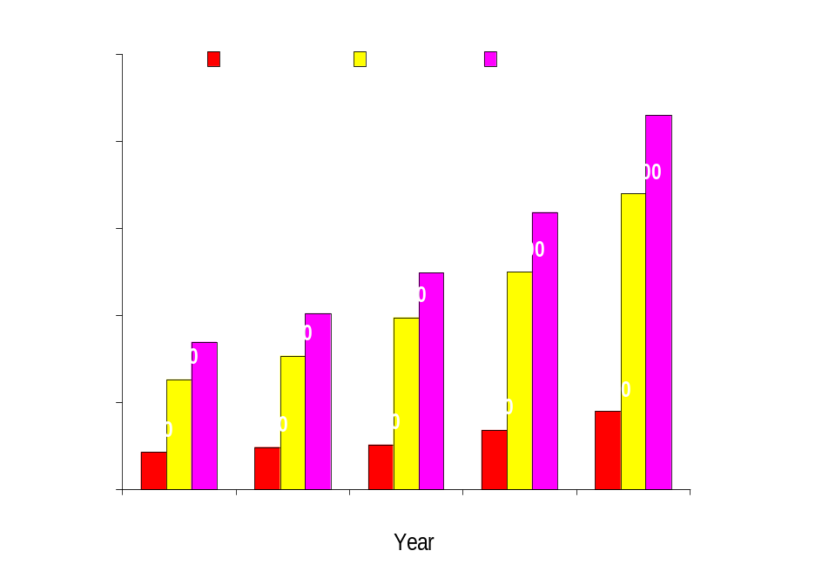
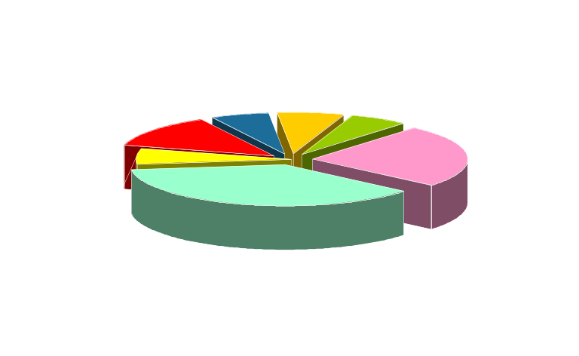
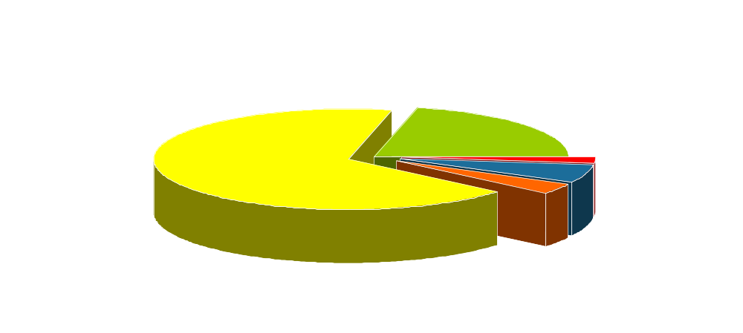
Indian Software: Global Brand
USD Million
By Verticals:
By Geography:
  Software & Services Grow over 30 %
~ 80% of Fortune 500 outsource their IT from India
Source: NASSCOM

Slide 12
India: The Emerging Global R&D Hub
The R&D outsourced market expect to cross 13.2 billion by 2010
Key research areas – VLSI, ASICS, RFid, Computer Architecture, Encryption Technologies, Computer graphics & multimedia, Programming Languages, Nano-technologies, opto-electronics, MEMs…
Patents out of India by MNCs:
Current patents by Indian entity
Design Engineers at Lead Companies
0 50 100 150 200 250
Texas Instruments
Intel
Oracle
Cisco Systems
GE
IBM
ICI
Whirlpool
SAP
Intel
2500
Motorola
1100
Texas Instruments
1450
Philips
2100
Sanyo
700
HP
2500
Cisco
2100
National Semi Conductor
950
IBM
2750
Source: Nasscom; Evalueserve; Naissance Capital; companies
The Economist, April 3-9, 2004

Slide 13
Harnessing The Indian Talent
World Class Educational Institutions
    Indian Institute of Sciences (IISc)
    Indian Institute of Technologies ( 7 IITs)
    Indian Institute of Management
    Indian Institute of Information Technologies (IIITs)
    IIITs and 1200 Engineering Colleges By 2008, the Indian IT Industry will be US$ 50 billion industry
1200 Engineering Colleges, 570 Business Schools and over 1800 Polytechnics
675, 000ContributeTechnical Graduates per Annum
  380,000 Engineers
  50,000 Management Graduates

Slide 14
India’s Value Proposition
Cost Arbitrage: 30 % of the cost of developed countries
Time Zone Advantage: 24X7 production runs by synchronizing work between on-shore and off-shore teams
Matured Processes: Over 50% of the SEI CMM Level 5 companies are based in India and most of the companies are ISO 9000 certified
Large talent pool: Over 800,000 high quality technical professionals growing at 20% p.a and Second largest English speaking scientific manpower
Balanced Eco System: Synchronized Govt. – Academia- Industry

Slide 15
India: Triple Advantage
IT Hardware market boom post ITA tariff alignment.
  A very rapidly growing domestic market: CAGR 30%+
Design and IP outsourcing:
  A proven case for embedded and IC design
Ready for Manufacturing Investments
  Cost –competitive; high skilled supply base
  Skilled employee base
Logistical proximity to EU and MEA market
  Freight Cost; 20% cheaper than China - Faster delivery and lesser pipeline inventory
Local Market
Profit from Local Sales
Advantage
India
Improve Costs & quality for Europe & NA
Use India in New Products
BPO
Electronic Design
India is a great Opportunity
–Triple Advantage

Slide 16
Indian Policy Structure: Globalization through Reforms
IT Agreement of WTO effective from March 01st 2005
Software Industry Totally deregulated: No Import Duties and No corporate Tax on Export earnings
Aggressive Telecom Reforms: Fastest Growing market in the world
E-Governance Initiatives: Opportunity of USD 5.0 Billions for Applications and Hardware.

Slide 17
IT Leaders in India…an indicative list
Software
  Infosys
  Wipro
  TCS
  Patni
  Satyam
  MNC’s
  Microsoft
  Oracle
  Computer Associates
  Honeywell
  IBM
BPO
  Wipro Spectramind
  IBM-Daksh
  WNS Global
  GE
  HSBC
  DELL
Telecom
    Motorola
    Ericsson
    Nokia
    Alcatel
    Samsung
    Siemens
    HFCL
    Bharti
    Benq
    ITI
Hardware
TVS-E
  HCL
  HP
  Wipro
  IBM
  Dlink
  ACER
  Samsung
  LG
  Flextronc
  Solectron
  Wep
Banking
World Bank
Standard Chartered
ABN AMRO
Fidelity
Citi Bank
R&D
  TI
  Intel
  IBM
  Motorola
  Wipro
  TCS
  Philips

Slide 18
VC – beginning to Discover India
VCs invested USD 800 million in 2003 and USD 1.1 billion in 2004 in 66 companies.
  Warburg Pincus invested USD 149 million in MoserBaer
  USD 148 million investment in BPO
  Over 20 PIPE (private investment in public enterprises) deals
India Specific VCs: ChrysCapital, GW Capital, ICICI Ventures, Infinity Ventures, Merlion, SIDBI, Walden International, Westbridge Capital etc.

Slide 19
Moving Forward: India Vision 2008
By 2008, the Indian IT Industry will be US$ 50 billion industry
Account for 7% of India’s GDP up from 4.1% currently
Contribute to 19% of the incremental GDP growth
Account for more than 30% of the foreign exchange inflows from 8% currently
Create employment opportunities for more than 4 million people
Domestic Hardware market slated to be US $ 44 B.

Slide 20
Threats
Cyberthefts
Financial & Banking frauds
Cyber defamation
Cyber frauds
E-mail threats
Hacking

Slide 21
Information Technology Act 2000
IT ACT 2000 enacted - a major step to facilitate e-commerce and e-governance
Provides legal framework for recognition of electronic contracts, prevention of computer crimes, electronic filing / documentation
Legalised digital signatures
Rules for implementing IT Act 2000 notified.
Controller of Certifying Authorities was appointed.

Slide 22
Telecom Policies
  ISPs permitted to set up International Gateways and hire Bandwidth on Foreign Satellites.
  Deregulation of National Long Distance Operations (NLDO).
  Opening up of the International Long Distance (ILD) Services to the private operators.

Slide 23
Why ICT in Judiciary System ?
Time for formulation of Strategic Plan for implementation of ICT in Indian Judiciary System
Availability of Robust Industrial and Communication infrastructure.
Availability of skilled manpower.
Implementation of Information Technology Act.
Availability of bandwidth on demand.
PC penetration
All time records lowest price for ICT equipments
Life period of equipment has been increased
Availability of Information Security Management System

Slide 24
Judicial Environment
Judge
Court Staff
Litigant
Prosecuting Agencies
COURT
Advocate
Prisons
Treasury
Government

Slide 25

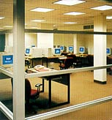



Stages of ICT Implementation
ICT Enablement
Development of ICT Culture
Initiation
Physical Presence of ICT infrastructure
Planning

Slide 26
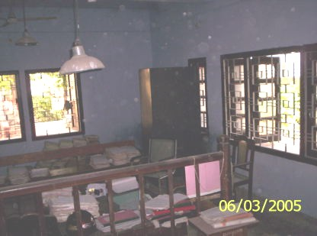
ICT TOOLS AND ITS RELEVANCE TO JUDICIAL PROCESS

Slide 27
ICT Tools in Indian Judiciary
INTERNET, WEBSITE AND EMAIL TOOLS
VIDEO CONFERENCING TOOLS
INTERCOMMUNICATION TOOLS
WEB ENABLED CONNECTIVITY
REGIONAL LANGUAGE TOOLS
PUBLISHING WORD PROCESSING TOOLS
STORAGE MANAGEMENT TOOLS
FINGERPRINT RECOGINITION TOOLS
TOOLS FOR ENCRYPTION, RECOGNITION AND DIGITAL SIGNATURE

Slide 28
ICT Tools in Indian Judiciary
VOICE RECOGINITION & RECORDING TOOLS
IMAGING AND SCANNING TOOLS
BAR CODE TECHNOLOGY
DOCUMENT MANAGEMENT
DATABASE MANAGEMENT SYSTEMS

Slide 29
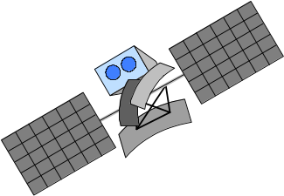


Connectivity Exchange
for Datacom Needs for Judiciary System
Intl.Fiber
to India
Satellite
Network Operations
Center
Court
Microwave Link
Terrestrial
Leased Line

Slide 30




Courts will be connected wherever located in the country !!
SATELLITE
Service Provider
Court
Court 1
Court 2

Slide 31
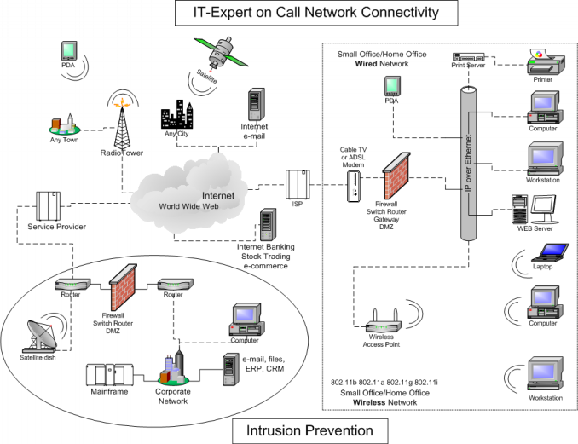

Slide 32
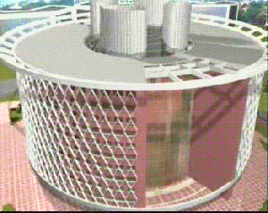




Typical Communication Environment
Satellite
Foreign Half Circuit
Customer Premises
Indian Half Circuit
Burum
Netherlands
Optical Fibre
Network
Berneveld,
Netherlands
Belgium
Trans Atlantic
Cable
(Fibre Optic)
International Fiber
International Gateway
ITMC USA
Dedicated
clients
Court Complex
Court Complex
INTERNET
Court Complex

Slide 33
Srinagar
Mohali/Chandigarh
Allahabad
Jaipur
Supreme Court
Guwhati
National Judicial Data Centre
Gandhinagar
Bhopal
Calcutta
Bhubaneswar
Navi Mumbai
Hyderabad
Bangalore
Manipal
Chennai
Thiruvananthapuram

Slide 34
Video Conferencing Tools
VC permits virtual interfacing of a judge with a witness,holding conferences,meetings.
Facilities would be installed in prison and in court premise or Judge office.
This virtual interaction will save a lot time and resources which would have been involved in physical transportation of prisoners.
It releases burden on police and concerned authorities

Slide 35
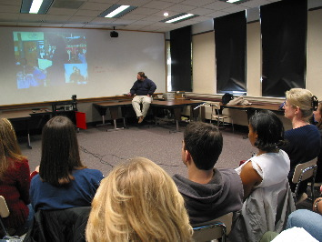
Video conferencing

Slide 36
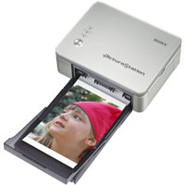

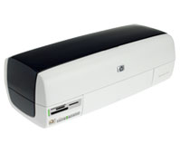
Publishing tools
Publishing tools would be utilized for various documentation of judicial system.
Enormous amount of paperwork done in judicial process can be done by printers ,scanners ,copiers etc.
Thus duplication of documents and files can be one faster and in short interval of time.

Slide 37
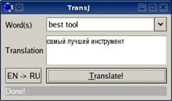
Word Processing Tools
It would involve producing various transcripts,data recording etc
They permit multilingual, electronics transcription, formatting an storage of oral evidences, order and judgements

Slide 38

Storage Management Tools
Enormous data generated in judicial process can be stored in soft form with proper indexing, filing of data records.
Exiting data of judicial system could be replicated to soft form to create database for future and can be stored in high end servers.
Various courts could have their localized storage of data

Slide 39
Regional Language Tools
Indian judicial system has been documented in various languages depending upon location of the courts.
This would be useful for general public litigation's.
These regional language tools would provide various documents that could be available for general public online or can be printed.

Slide 40
Internet Website and e-mail tools
Website and internet tools such as web browsers,etc would be required for viewing if the created database of documents
E-mails would facilitate in issuance of summons,notices ,warrants etc.
Various information like case status, cause list, can also be known online.

Slide 41
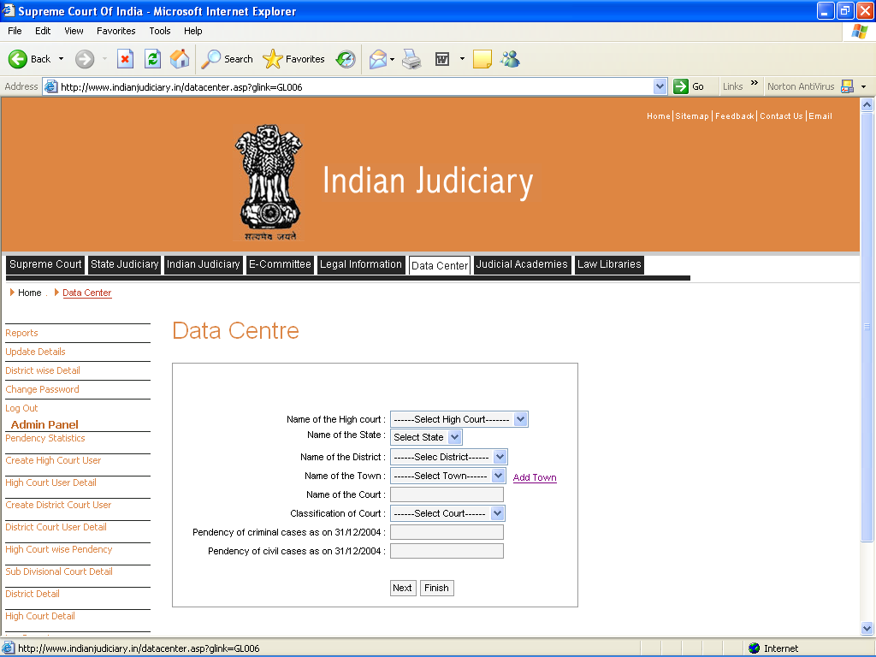

Slide 42

E-mails(instant messages to all designated persons)

Slide 43
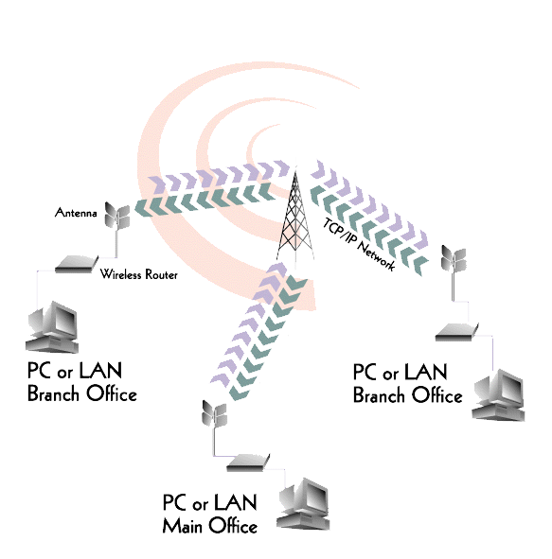
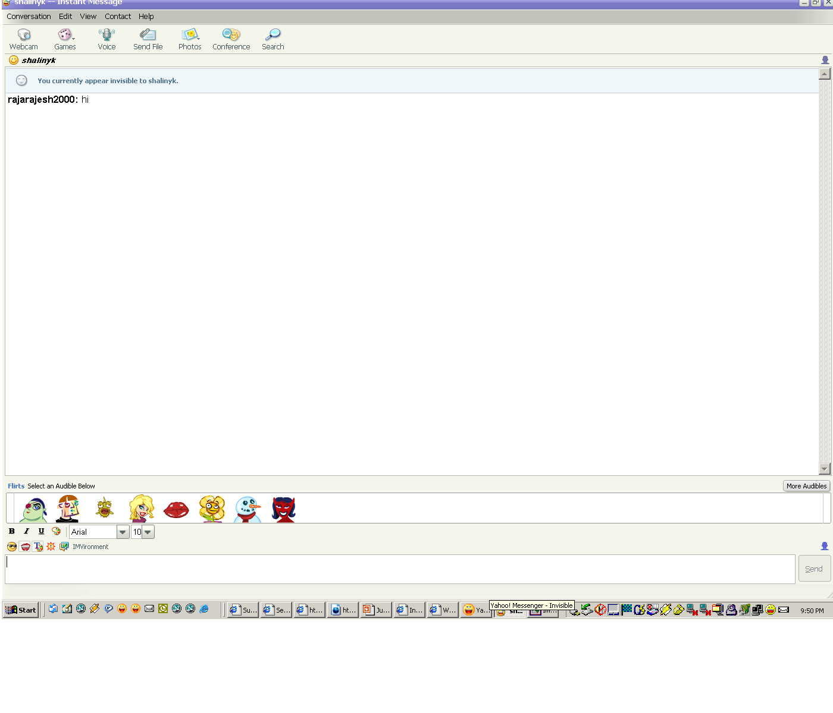
Intercommunication tools
These are namely chatting, e-mails etc.
Useful for intercommunication within judicial system.
It is much better than existing paper based way of communication as it is reliable , faster and efficient.

Slide 44
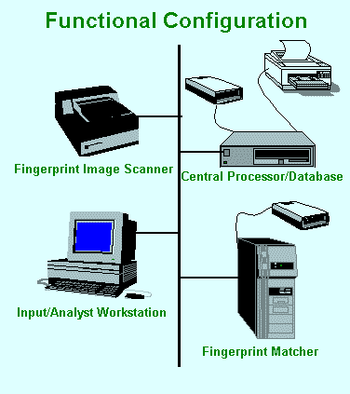
Fingerprint recognition system
It would involve fingerprinting of accused,witness, prisoner etc.
A centralized data base of fingerprints would be created. It could act as a reference during identification of professional criminals.
It would also identify professional litigants and professional witnesses thus help in preventing of their impersonation.

Slide 45
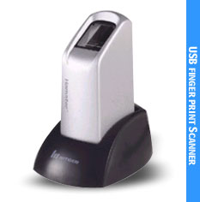
Fingerprint recognition devices

Slide 46
Tools for encryption,Recognition of digital signature
They enable the recognition of digital and perform various encryption and decryption functions which may act as a security tool for documents and avoid hacking by miscreants.
These ensures confidentiality and non-repudition of documents.
They can be meaningfully used to grant certified copies of orders and judgements.

Slide 47
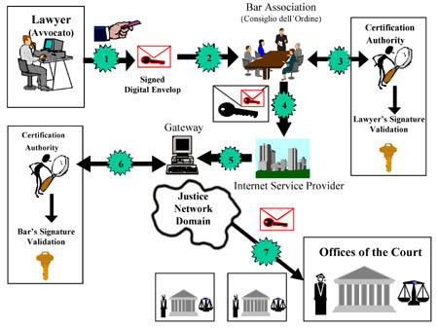
Example of Italian Court

Slide 48
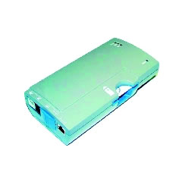
Voice recognition and recording tools
Can be utilized for the task of dictation,voice recording etc.it would be helpful in dictation given by judges
Manual work of dictation can be taken care by voice recognition systems.
But experiences show that this tool hardly stores 80% to 85% of the words spoken.

Slide 49
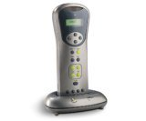
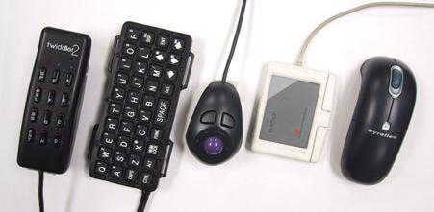
Various voice recognition devices

Slide 50
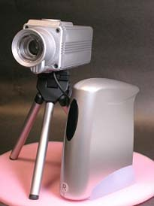
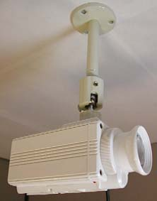
Imaging and scanning tools
It would assist in storage and management of documentary evidence, photographs of accused,and litigation witnesses for future identification.

Slide 51
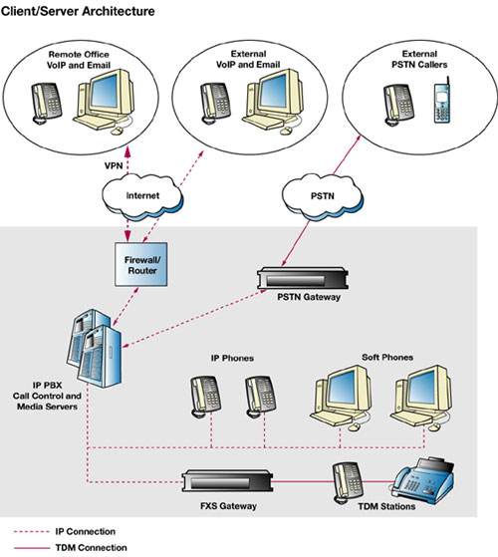
Web enabled connectivity
Using RDBMS and WAN it is feasible to create national grid of court information for judicial reviews at all hierarchical levels.
Thus centrally available data well devised national policies pertaining to delay reduction (I.e arrears-control),programs can be conveniently implemented.
The data can be filtered to data warehouse of judiciary where it can be used by centralized research and planning for judiciary and experts can evolve centralized policies for courts.

Slide 52
Bar code technology
Standard bar codes can act as social security numbers or in context of courts like case numbers which can act as reference numbers that a computer uses to look upto associated descriptive data and other pertinent information.
This technology helps in document management and movable property identification.
Bar code scanner is faster than human eye and far more accurate.it has an accuracy of one error per ten million.

Slide 53

Bar code technology
Bar code can be used to locate files,documents concerning to cases like pleading issues,evidence both oral and documentary, orders , judgments as also movable properties seized,attached and exhibited.
This technology is very effective in tracking of files and their location.

Slide 54
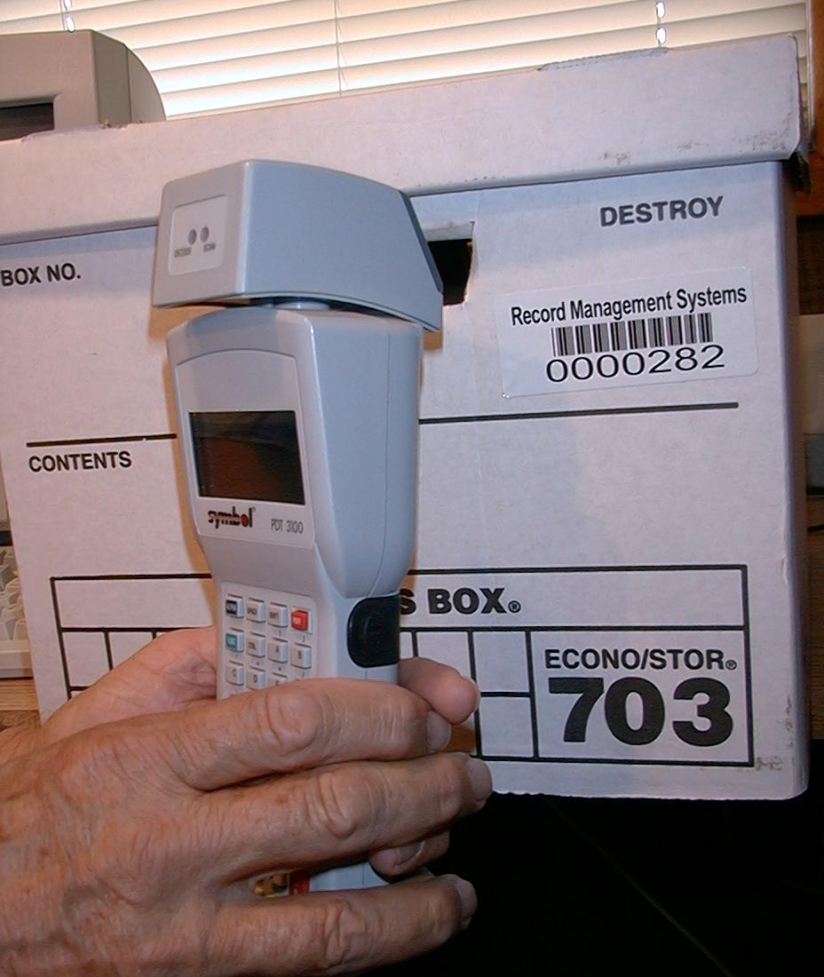
Barcode reader

Slide 55
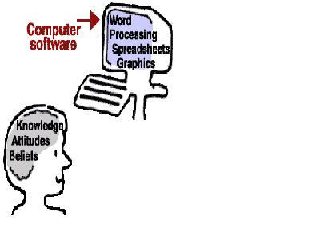
Document management
Document management was originally developed to control and manage information flows in corporate, non profit and government organizations.in essence the goal was to organize files.
Document management can be effectively used in transpiration and storage of judicial documents.
One would no longer require use of manual typewriter.

Slide 56
Document management
The basic advantage of using document management tools like cut and paste instead of retyping and ability to make corrections without use of erasing liquid, transfer of documents from one work station to another on click of mouse would be of immense help in lessening the manual work.

Slide 57
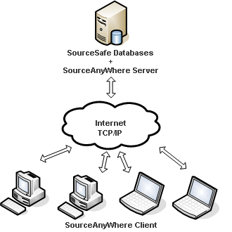
Data base management system
It helps in effective court management,case management and case flow management.
Judicial system its settled object is to provide speedy and affordable justice.the question is why Indian judicial system is not resolve the disputes speedily.
For solving the above problem,we must posses some primary information, to begin with whether there are sufficient courts to to cope with cases filed

Slide 58
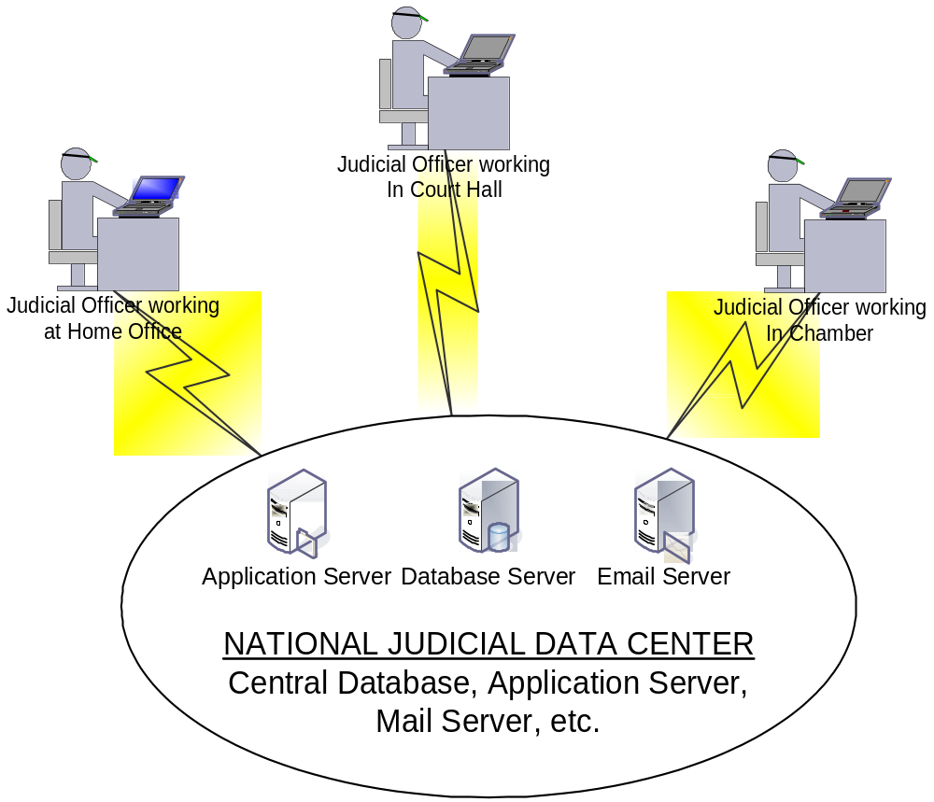

Slide 59
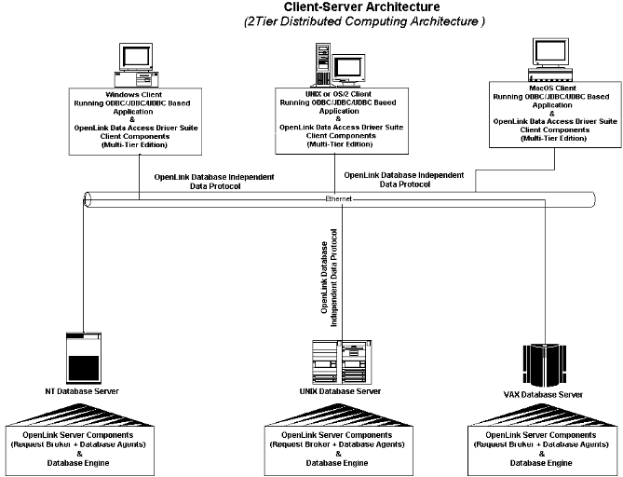

Slide 60
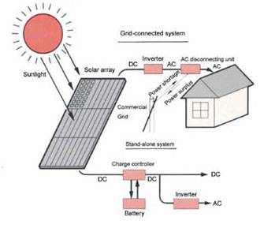

Slide 61
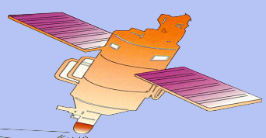


COURT INFORMATION CENTRES
National Judicial Data Centre
High Court
High Court
High Court
Subordinate Court
Subordinate Court
Subordinate Court
Subordinate Court
Subordinate Court
4

Slide 62

Dhanyawad

